Slide 1
Lecture 1a: Introduction to Functional and Logic Programming Paradigms
CS 352 – Dr. Lan Yang

Slide 2
Symbolic Programming
Manipulate mathematical equations and expressions in symbolic form, as opposed to manipulating the approximations of specific numeric quantities represented by those symbols.
symbolic computation vs. numeric computation
Advantage
With all objects represented in a uniform way, computing reduces to just one fundamental operation: transforming one expression into another.

Slide 3
Programming Paradigms
Programming or program in general
A sequence of instructions for machines
Procedural or imperative languages
Based on the idea of instructions to be carried out like a recipe (step-by-step)
Extensively uses control flow
Declarative/applicative languages
Design not so much influenced by particular machines details but rather by a clear mathematical understanding of descriptions
Expresses the logic of computation without using control flow
Others such as object oriented …

Slide 4
Declarative Languages
An umbrella term that includes a number of better-known programming paradigms
Functional programming languages
Logic programming languages
Both functional programming languages and logic programming languages are good tools for symbolic computation

Slide 5
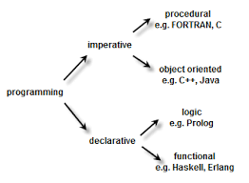

Slide 6
Functional Programming
Functional programming, and in particular purely functional programming, attempts to minimize or eliminate side effects, thus, considered declarative.
What is side effect?
Most functional programming languages (FPL), however, do permit side effects in practice.
LISP is not a purely FPL
Scheme, Haskell considered as purely FPLs
Scheme: A mid-1970s dialect of LISP, designed to be a cleaner, more modern, and simpler version than the contemporary dialects of LISP

Slide 7
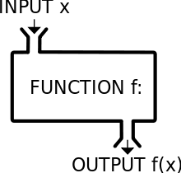

Slide 8
Fundamentals of FPL
Objective:
mimic mathematical functions to the greatest extent possible
The basic process of computation is fundamentally different in a FPL than in an imperative language
In an imperative language, operations are done and the results are stored in variables for later use
Management of variables is a constant concern and source of complexity for imperative programming
In an FPL, variables are not necessary, as is the case in mathematics
Notes:
8

Slide 9
Fundamentals of FPL (continued)
Referential Transparency - In an FPL, the evaluation of a function always produces the same result given the same parameters
Tail Recursion – Writing recursive functions that can be automatically converted to iteration
What is tail recursion?
linear search
What recursion is not tail recursion?
factorial numbers
(more to be discussed later)
Notes:
9

Slide 10
A Sample Functional Program
#Python: factorial (n) n>=0
def factorial (n) :
if n == 0 :
return 1
else :
return n * factorial (n-1)
print(factorial(5))
; Lisp: factorial (n) n >=0
(defun factorial (n)
(if (= n 0)
1
(* n (factorial (- n 1))) ) )
(factorial 5)

Slide 11
Logic Programming
Logic Programming Paradigm
use of mathematical logic for computer programming
based upon the fact that a backwards reasoning theorem-prover applied to declarative sentences in the form of implications:
If B1 and … and Bn then H
treats the implications as goal-reduction procedures:
to show/solve H, show/solve B1 and … and Bn.

Slide 12
Example
it treats the implication:
If you press the alarm signal button,
then you alert the driver of the train of a possible emergency
as the procedure:
To alert the driver of the train of a possible emergency,
press the alarm signal button.

Slide 13
History of Logic Programming
Roots in automated theorem proving
Computation as deduction
Uses first-order logic
Mostly in the field of logic
Much later to the field of computer science
Prolog
A practical realization of the idea of logic programs
Started as a programming language for natural language processing
Later thinks it could fit as a general-purpose programming language

Slide 14
A Sample Prolog Program
Database (i.e. facts)
likes(john, flowers).
likes(john, mary).
likes(paul, mary).
likes(mary, book).
Question (i.e. problem to be solved)
?- likes (john, X). //X initially not instantiated
Is there anything John likes?
Prolog’s response is: (i.e. program result/output)
X=flowers //now X is instantiated
However, there are more than one things John likes.
If we want to see all answers from Prolog, type ‘;’ after Prolog types out the answer.
X=flowers;
X=mary;
no

Slide 15
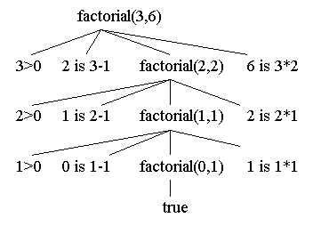
Prolog program: factorial
factorial(0,1).
factorial(N,F) :-
N>0,
N1 is N-1,
factorial(N1,F1),
F is N * F1.
?- factorial(3, R)
R=6

Slide 16
What are we going to study?
Functional ?
Logic ??
What’s your choices?
Please complete the blackboard survey now!
On blackboard, under Assignments link

